Slide 1

Application of Machine Learning for Predicting Air Quality
Insights from my Internship at DKRZ

Slide 2
My Main Task during my Internship at DKRZ

Slide 3
My Main Task during my Internship at DKRZ
Getting familiar with ML
Learning about different ML methods
Writing a code predicting air quality using a weather dataset provided by a weather station in Billwerder

Slide 4
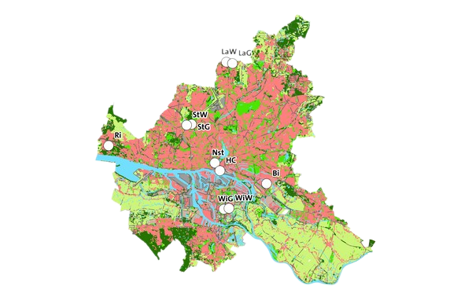
My Main Task during my Internship at DKRZ
Writing a code predicting air quality using a weather dataset provided by a weather station in Billwerder
Input Features:
temperature
wind direction + speed
humidity
air pressure
(mean value of y)

Slide 5
My Main Task during my Internship at DKRZ
Writing a code predicting air quality using a weather dataset provided by a weather station in Billwerder
Output:
particulate matter
sulfur dioxide
nitrogen dioxide
nitrogen monoxide

Slide 6





Getting used to jupyter lab and various libraries associated with ML

Slide 7
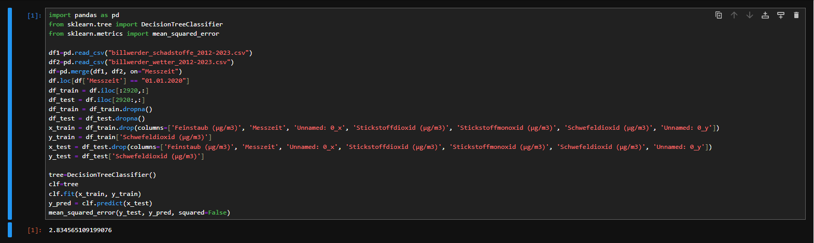
Method1: Decision Trees

Slide 8
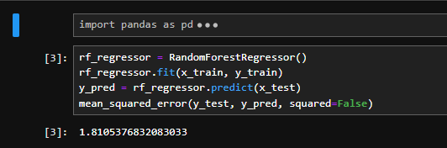
DecisionTreeClassifier
Splitting data into train (2012-2019) and test (2020-2023) sets
DicisionTreeClassifier
RMSE: 2.834565109199076

Slide 9
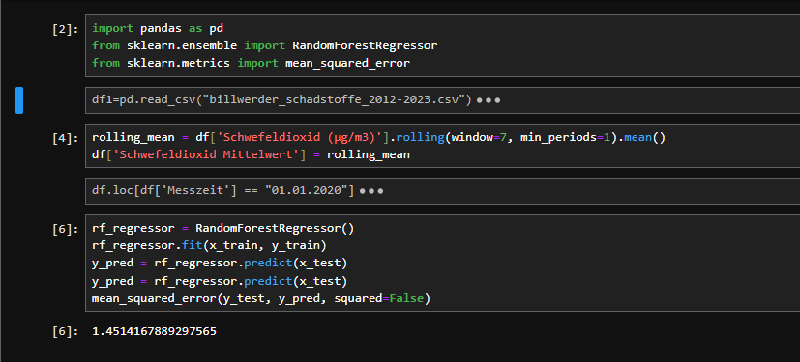
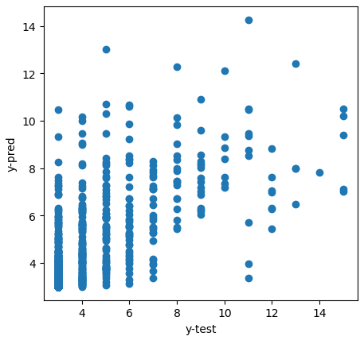
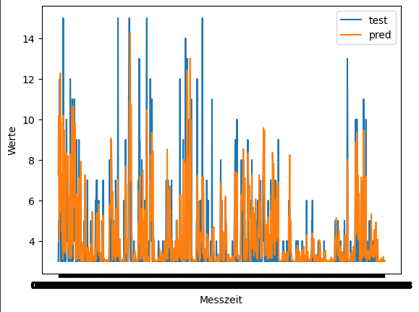
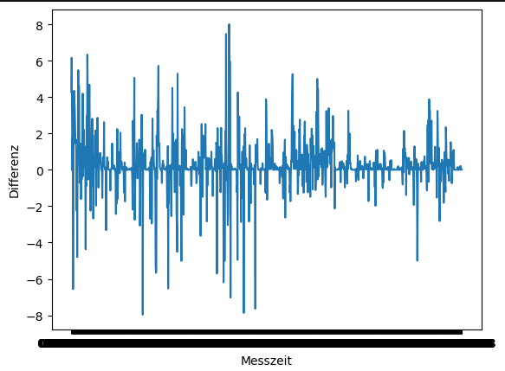
RandomForestRegressor
RMSE: 1.8105376832083033

Slide 10
RandomForestRegressor
Adding the mean value of 'Schwefeldioxid (µg/m3)' as a feature
RandomForestRegressor
RMSE: 1.4524267889297565

Slide 11
RandomForestRegressor
RMSE: 1.4524267889297565

Slide 12
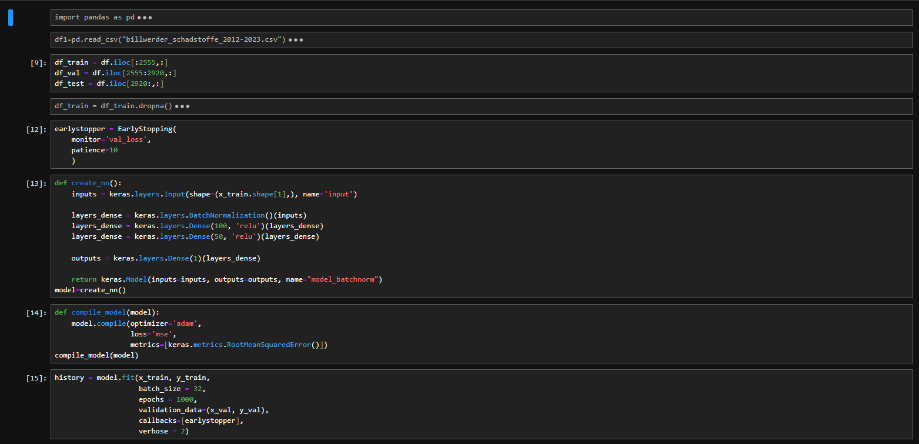
Method2: Neural Networks

Slide 13
Neural Network
Adding a validation set
Applying early stopping
Creating a neural network
Compiling model
Training model
RMSE: 1.663954955491914

Slide 14
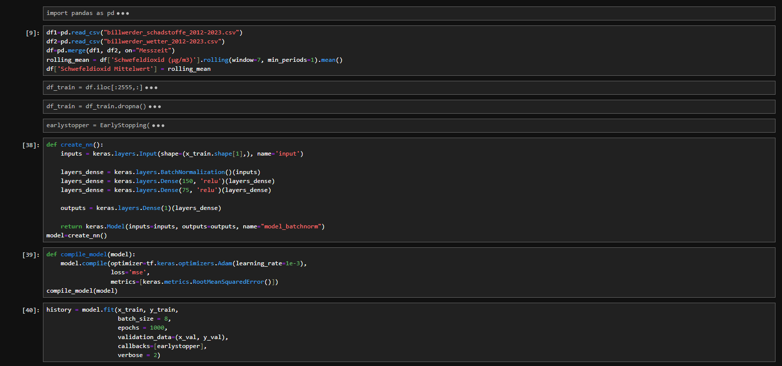
Neural Network
Adding the mean value of 'Schwefeldioxid (µg/m3)' as a feature
Changing the number of neurons
Changing batch size to 8
RMSE: 1.4924199714770645

Slide 15
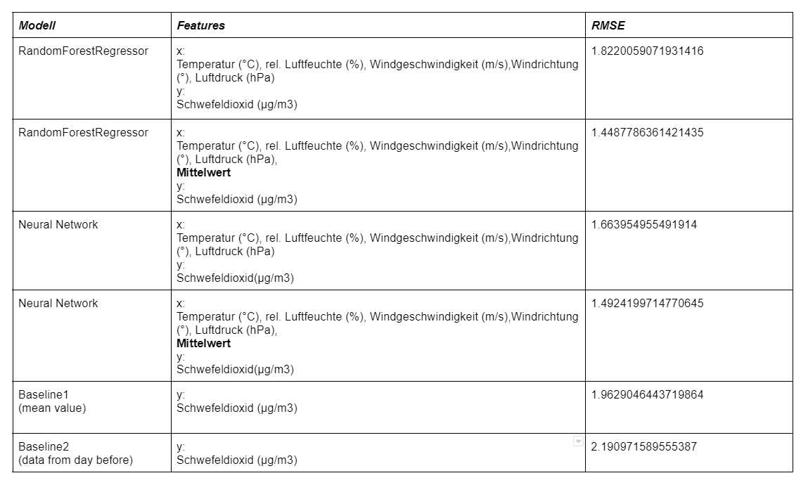
Comparing the Methods

Slide 16
Comparing the Methods

Slide 17
Thank You

